Slide 1
Sesión II Cartas de control y análisis de capacidad

Slide 2
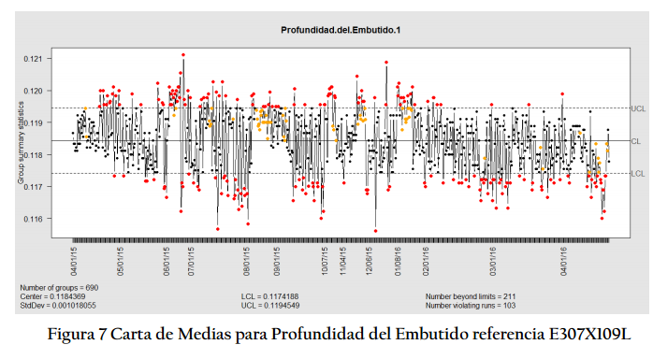

Slide 3
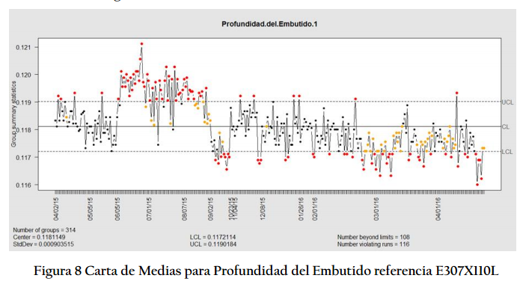

Slide 4
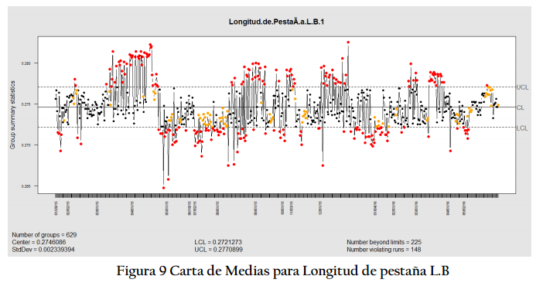

Slide 5
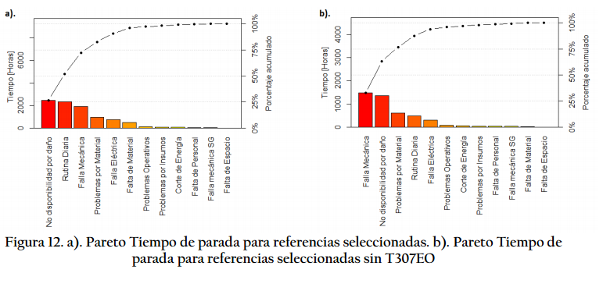

Slide 6
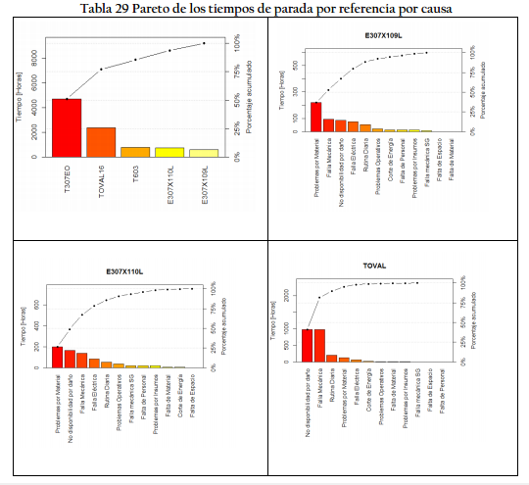

Slide 7
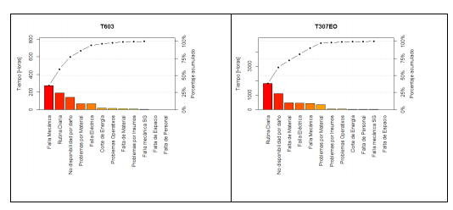

Slide 8
Referencias
LIBRO DE EJEMPLO DE RIO
Alzate, A., López, M. E., & Serna, C. (2016). Recovery of gold from waste electrical and electronic equipment (WEEE) using ammonium persulfate. Waste management, 57, 113-120.
Fox, J. and Weisberg, S. (2011). An {R} Companion to Applied Regression, Second Edition. Thousand Oaks CA: Sage. URL: http://socserv.socsci.mcmaster.ca/jfox/Books/Companion.
Gross, J. and Ligges, U. (2015). nortest: Tests for Normality. R package version 1.0-4. https://CRAN.R-project.org/package=nortest.
Gutiérrez, P.H. & De La Vara, S. R. (2012). Análisis y diseño de experimentos. McGraw-Hill. Edición 3.
Hamze, H., Akia, M., & Yazdani, F. (2015). Optimization of biodiesel production from the waste cooking oil using response surface methodology. Process Safety and Environmental Protection, 94, 1-10.

Slide 9
Referencias
Mendiburu, F. (2017). agricolae: Statistical Procedures for Agricultural Research. R package version 1.2-8. https://CRAN.R-project.org/package=agricolae.
R Core Team (2018). R: A language and environment for statistical computing. R Foundation for Statistical Computing, Vienna, Austria. URL https://www.R-project.org/.
RStudio Team (2018). RStudio: Integrated Development for R. RStudio, Inc., Boston, MA URL http://www.rstudio.com/.
Zeileis, A. & Hothorn, T. (2002). Diagnostic Checking in Regression Relationships. R News 2(3), 7-10. URL
https://CRAN.R-project.org/doc/Rnews/.

Slide 10
Muchas gracias

